Slide 1
Twitter and Politics
Dr. Anne Regel
March 23th, 2018

Slide 2
Introduction
Politicians are increasingly using Twitter to communicate directly with the public
All 100 senators have official twitter accounts
All but 7 congresspersons have twitter accounts
Presidents and Prime Ministers
France, Russia, Venezuela, UK and Israel
What can 280 character's do?
Effect stock prices
Influence diplomacy
Inspires violence

Slide 3
Twitter and President Trump
This capstone project will analyze President Trump’s tweets. Some of the questions I will try to answer are:
What does President Trump tweet about?
Do his tweets translate into official actions of any kind?
My clients would include anyone interested in using twitter statements in order to anticipate future actions made by the President of the United States of America

Slide 4
Data Acquisition
Twitter
Tweets from 01/20/2017 – 03/03/2018 obtained from Trump Twitter Archive
Tokenized tweet text
All documents published by the Executive Office of the United States of America
Scraped all documents from the Federal Register’s website
Converted PDF to text
Tokenized each documents text

Slide 5
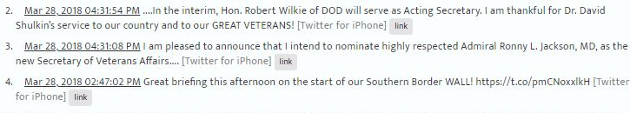
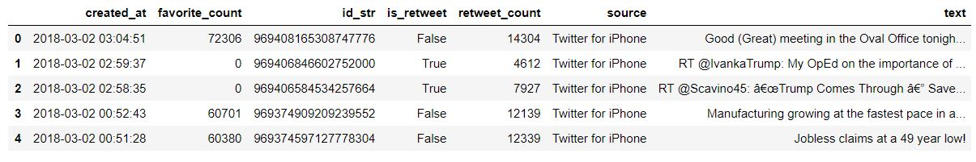
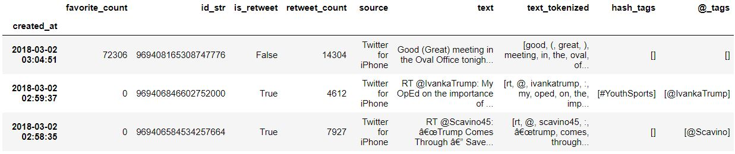
Twitter Data Wrangling
Download JSON data from Trump Twitter Archive
and load into a Pandas dataframe
Extract hashtags, @mentions, tokenize text, and convert dates to datetime objects

Slide 6
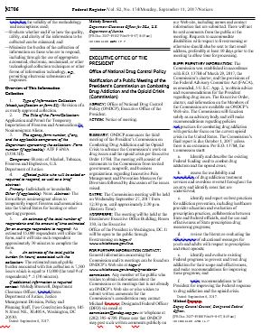
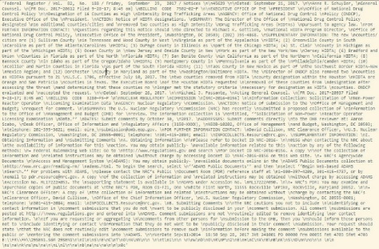

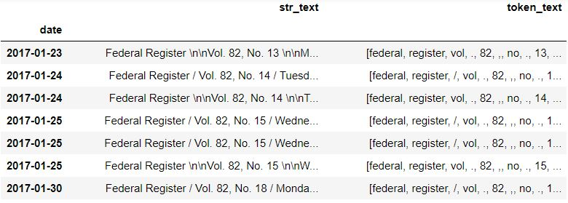
Federal Document Data Wrangling
PDF of Federal Document
Convert to Plain Text
Date of publication
Extract
Text of Federal Document
Tokenize Text
Tokenized text
Put all Federal Data into a Pandas dataframe
Clean and Formatted Data

Slide 7
Exploratory Data Analysis and Visualization

Slide 8
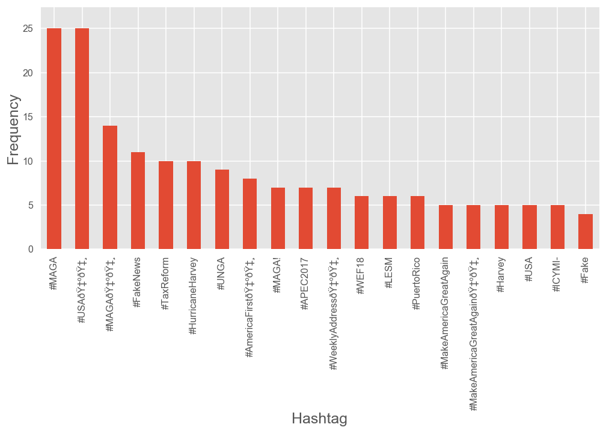
Top 20 Hashtags

Slide 9
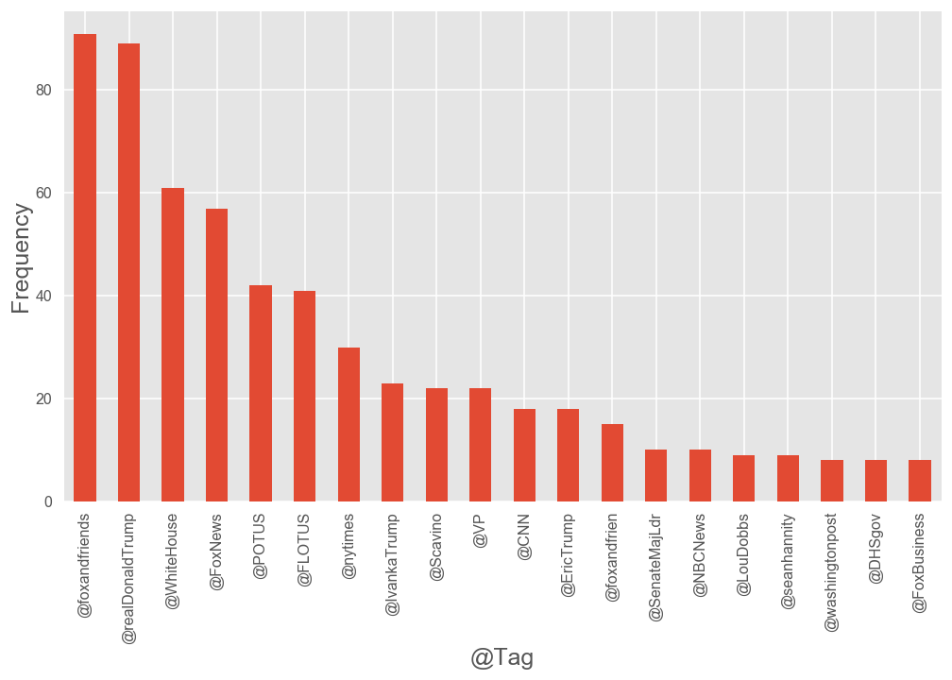
Top 20 @tags

Slide 10
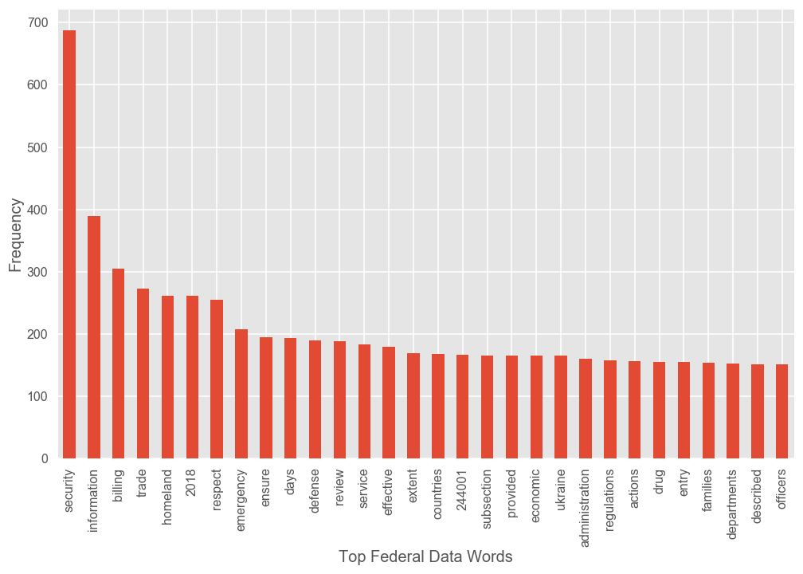
Top 30 words used in federal documents published by the Executive Office

Slide 11
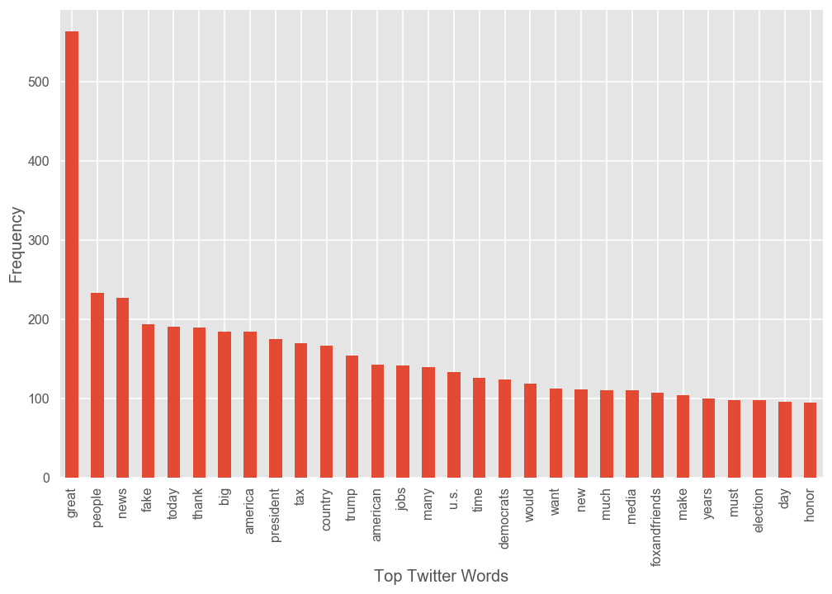
Top 30 words used in Donald Trump’s tweets

Slide 12
Top 30 words used in Donald Trump’s tweets

Slide 13
Cosine Similarity

Slide 14
Analysis Results

Slide 15
Topics of Similar Documents

Slide 16
Conclusion

